Slide 1
Hackathon, 2017
Team Name: ONE
College: Baba Farid College of Engineering & Technology
Team Members: Saimon Thada, Shubham Goyal and Warun Sharma
Topic: Indian Emergency Response Portal

Slide 2
Problem Statement
India has a very large population. So, it is very tedious to respond by any Emergency Departments as quick as possible. Due to unavailability of organized Emergency Response System in India costs millions of life and billions of money every year. In this digital era, our country has no quick and at any moment available emergency response portals. And if available it is not helping everyone efficiently.
To Conquer this problem...

Slide 3
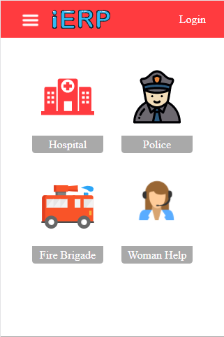
Solution Proposed
Our Indian Emergency Response Portal can help any citizen of India for police, fire brigade, paramedics related emergency. We have also encountered the women related emergency problems like rape situations, molestations and eve-teasing.
We developed a system which sends victim’s request to the respective and nearest department with their exact current location. Now victim can see the real time response of the respective department on the request send.

Slide 4
Technical Design
Presentation Layer: It is the first layer of our project. It provides user an interactive UI.
Business Logic: Google Map API and other Web API.
Database Access: It contains data of the required users and departments. Like user’s aadhar card details, department details, etc.

Slide 5
Technology used
Front End: HTML, CSS, JS, AJAX,JQERY.
Back End: PHP.
Database: MYSQL.

Slide 6
Hardware Requirements
All standard requirements.

Slide 7
Assumptions
Person using our web app should be the registered user .
Department should be always logged in to our systems .

Slide 8
Thank You

